Slide 1

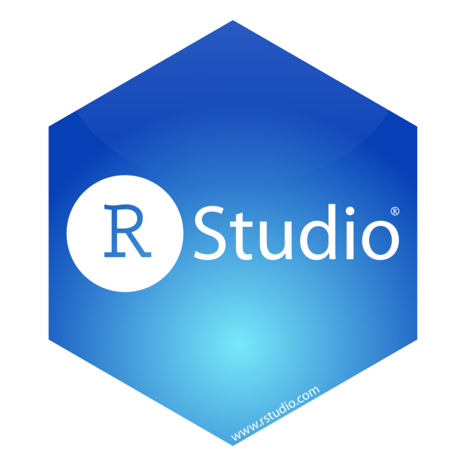
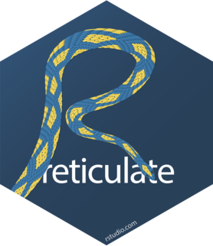


Doing Analytics with R (and Python) in RStudio
Professor Matthew Lanham
Academic Director, MS BAIM Program
Associate Director of Student Engagements,
Krenicki Center for Business Analytics & Machine Learning
MatthewALanham.com
Notes:
http://krannert.purdue.edu/news/press/Logo.asp

Slide 2
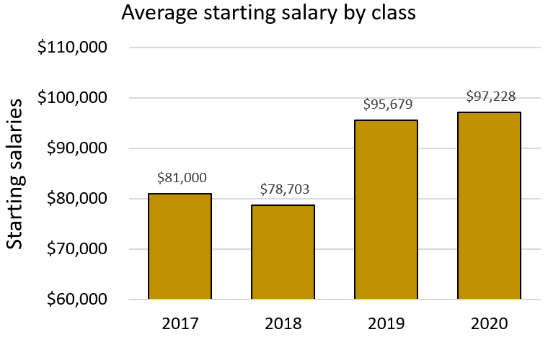
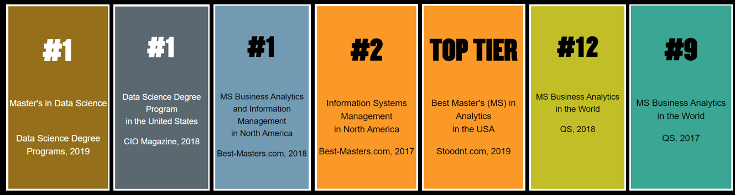

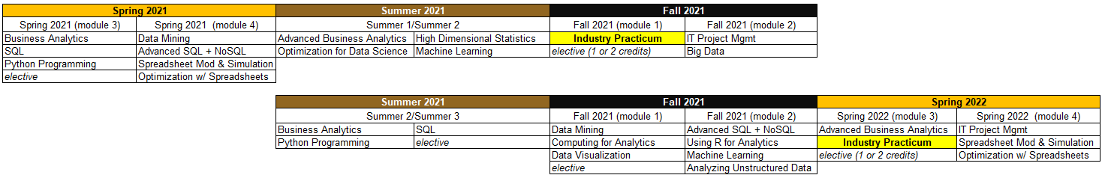
Mostly scope and mentor experiential learning projects for MS BAIM students
Typical plans of study for both cohorts:
Jan 19
Mar 15
May 17
Jun 14
Aug 23
Oct 18
Jan 10
Mar 7
May 7
https://github.com/MatthewALanham/2021_MWDSI
2
Notes:
http://meetings2.informs.org/wordpress/analytics2019/

Slide 3
I teach a Using R for Analytics course
8-week course designed for MS BAIM students
Provide additional optional R materials on tidymodels and reticulate
Slides and codes of other more focused methods on various data mining and predictive analytics topics
https://github.com/MatthewALanham/2021_MWDSI
3

Slide 4
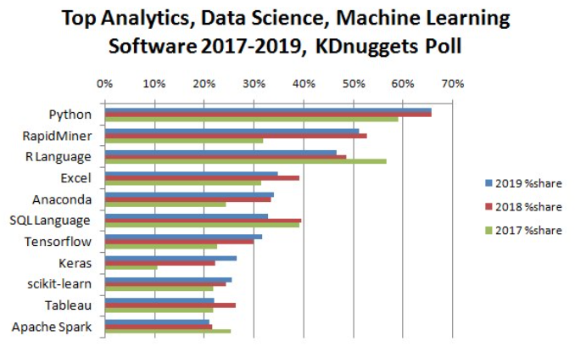
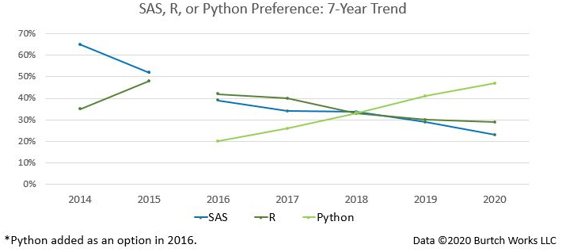
R and Python
R and Python continue to be at the top of software used by data science and analytics practitioners, but python continues to gain in popularity over R
Source: kdnuggets.com, 2020 [link]
Source: Burtch Works Executive Recruiting, 2020 [link]
https://github.com/MatthewALanham/2021_MWDSI
4

Slide 5
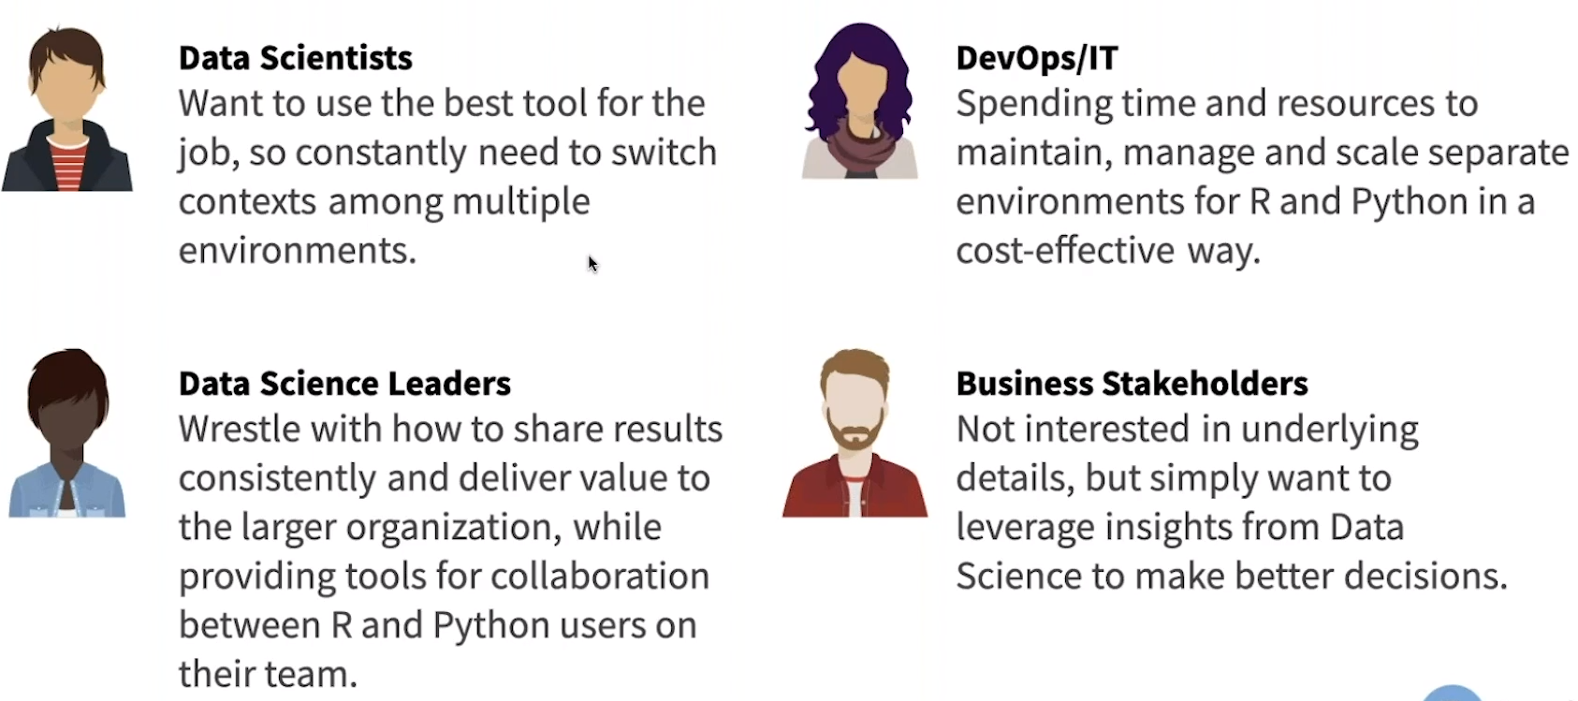
Why R & Python in RStudio?
Check out Lou Bajuk and Sean Lopp’s “R & Python: A Data Science Love Story”
Data Scientists can use R & Python together in a single data science project
IT/DevOps can support those Data Scientists more easily in a single development infrastructure
Bilingual Data Science teams can more efficiently collaborate and share their work with their business stakeholders
https://github.com/MatthewALanham/2021_MWDSI
5

Slide 6


Setting up Python
I followed the recommended instructions provided on RStudio’s website [link]
1
Create a New Project…
2
Navigate to that project in python and run the following two commands (i.e., I just used the Anaconda Powershell)
https://github.com/MatthewALanham/2021_MWDSI
6

Slide 7
Setting up Python
I followed the recommended instructions provided on RStudio’s website [link]
3
Create a virtual environment and activate your Python environment
4
Install any python packages you want
5
Go to RStudio and install the reticulate package and set your python path (coming up in reticulate_ex.R script)
If you run into any snags, check out this video [link]
https://github.com/MatthewALanham/2021_MWDSI
7

Slide 8
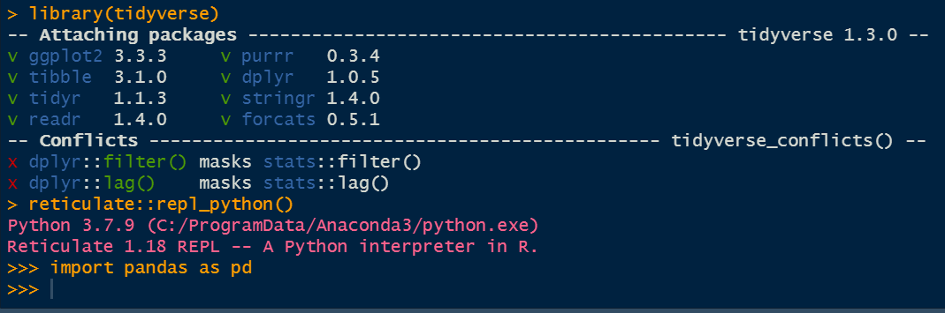
reticulate_ex.R
Let's look at some examples
Load reticulate library and see python version you are using
How to flip back and forth among the R and Python consoles using repl_python()
Show that you can create Python scripts in RStudio and how repls change
Show how you can run your python script in the Terminal or use ‘Source Script’ to call running your .py file
https://github.com/MatthewALanham/2021_MWDSI
8

Slide 9
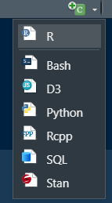
Rmarkdown_ex.rmd
Originally R Markdown could only contain R code. Today, there are several languages that can be knitted into these documents
Create a new R markdown file (File->New File->R Markdown…)
Show how you can add R or Python code chunks
Load in a dataset from the python seaborn library
Plot the data that came from python using R’s ggplot2 library
Use python pandas library to read in a csv file
Load in the iris dataset from the R datasets
https://github.com/MatthewALanham/2021_MWDSI
9

Slide 10
Data Scientist Take-aways
RStudio is NOT yet a full-fledged IDE for Python like Spyder or Jupyter Lab, but provides the convenience to work in one IDE on data and have the tools from both language available to you which will likely be sufficient for many people
R Markdown is similar to a Jupyter Notebook in that it provides a way to do literate programming where you combine text/prose with code output in one single computational document
The py$ object gives you access to the python environment and all data/variables that is available in that environment
The reticulate package uses C++ APIs making the data conversions fast for the languages to talk back and forth
https://github.com/MatthewALanham/2021_MWDSI
10

Slide 11
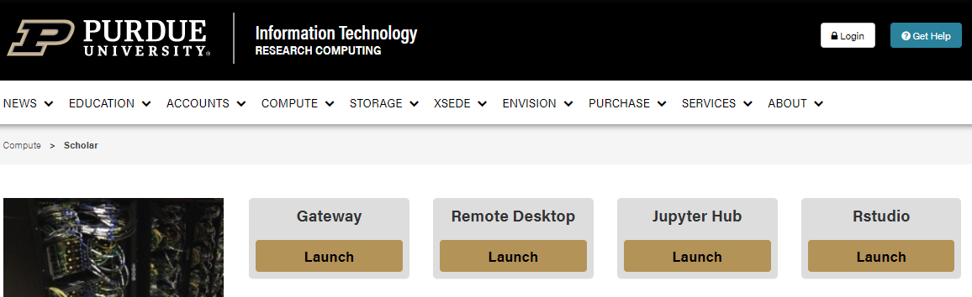
DevOps/ IT admin perspective
It is a challenge for IT to provide the infrastructure to support multiple languages and tools as packages fail, job conflicts, unsupported platforms, etc.
Most teams today are working in a cloud-based environment
https://github.com/MatthewALanham/2021_MWDSI
11

Slide 12
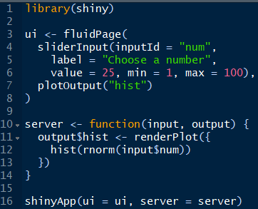
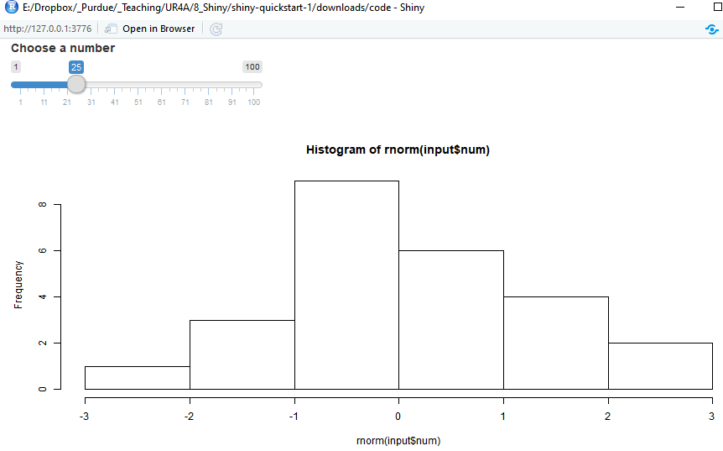
app.R
A team could also incorporate python code into a shiny application and easily deploy the dashboard or tool to the decision-maker.
Input function
Output function
inputId & input$ match
outputId & output$ match
https://github.com/MatthewALanham/2021_MWDSI
12

Slide 13
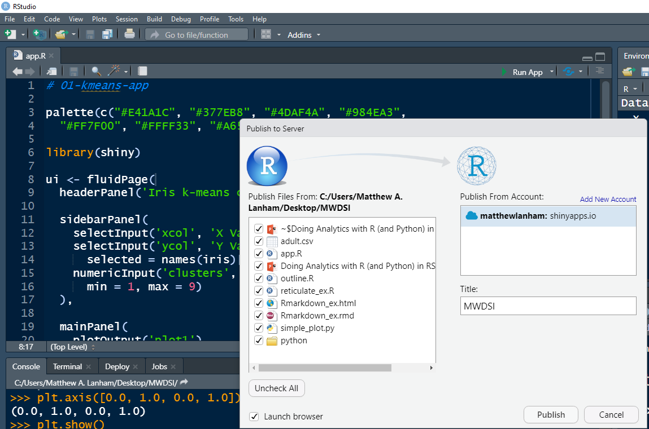
Deploying an app for decision support
Say this simple shiny app is our team’s decision-support tool that we want to share with others via a url.
1
Click the blue eye icon
2
Choose the server location where you would like your app hosted
3
Provide name of app
https://matthewlanham.shinyapps.io/MWDSI/
https://github.com/MatthewALanham/2021_MWDSI
13

Slide 14
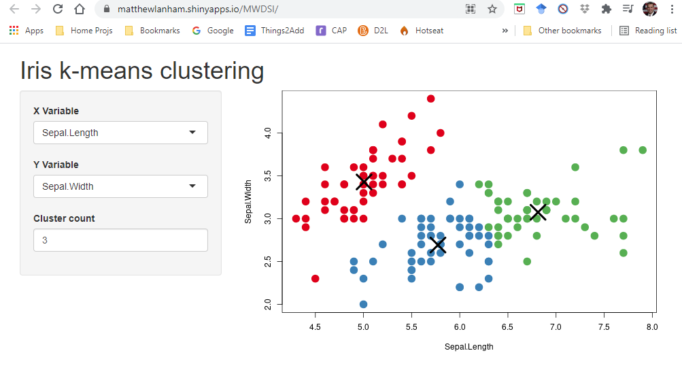
Deploying an app for decision support
https://matthewlanham.shinyapps.io/MWDSI/
4
Share the link of your app or dashboard with those users
The end user know or care if you used python, R, or something else, and won’t care.
Shinyapps.io is just one place you could host your app. I’m using a free account here, so my app is public. Companies have paid accounts with private, and password protected apps, but the process is exactly the same.
https://github.com/MatthewALanham/2021_MWDSI
14

Slide 15
DevOps/ IT Admin Take-aways
It is a challenge for IT to provide the infrastructure to support multiple languages and tools as packages fail, job conflicts, unsupported platforms, etc.
RStudio provides a product called RStudio Team with is part of RStudio Server
Provides a single infrastructure for R & Python
Enable user's favorite tools: RStudio, Jupyter Notebook
Configure, integrate, and scale in one environment across different teams
https://github.com/MatthewALanham/2021_MWDSI
15

Slide 16
DS Leader & Business Stakeholder perspectives
Data Science leader
They are managing multi-lingual team members and need them to effectively collaborate and share work
They need to deploy timely interactive analyses, dashboards, reports, and decision-support tools
Business Stakeholder
they want good insights…yesterday ☺, so they can make better decisions
https://github.com/MatthewALanham/2021_MWDSI
16

Slide 17
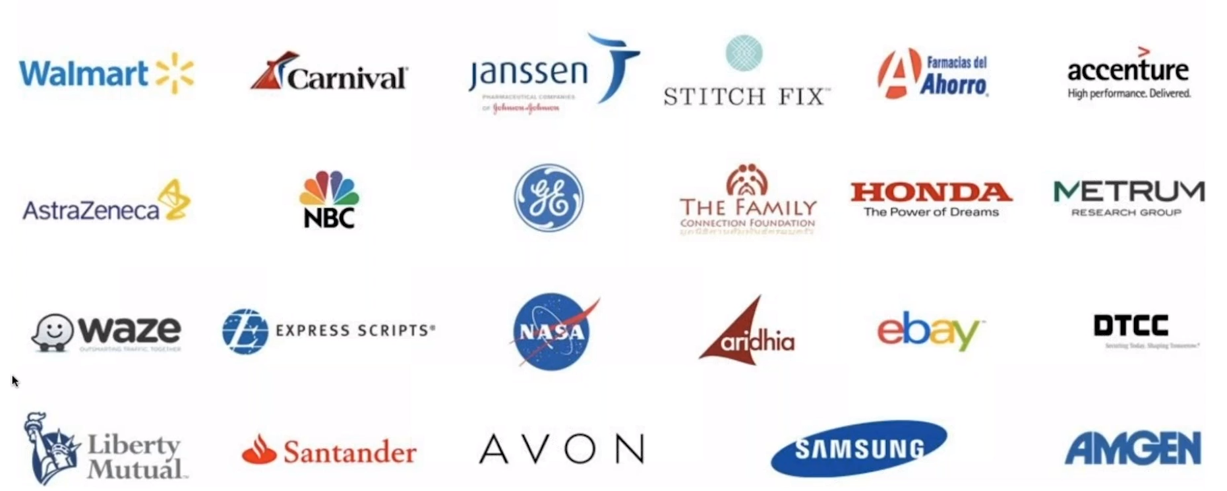
Known companies doing this today
These companies are just a sample that are working with multi-lingual (R, Python, Spark, etc.) teams that need to scale up their analytics and get it into production quickly to leverage their investment and maximize impact
https://github.com/MatthewALanham/2021_MWDSI
17

